Slide 1


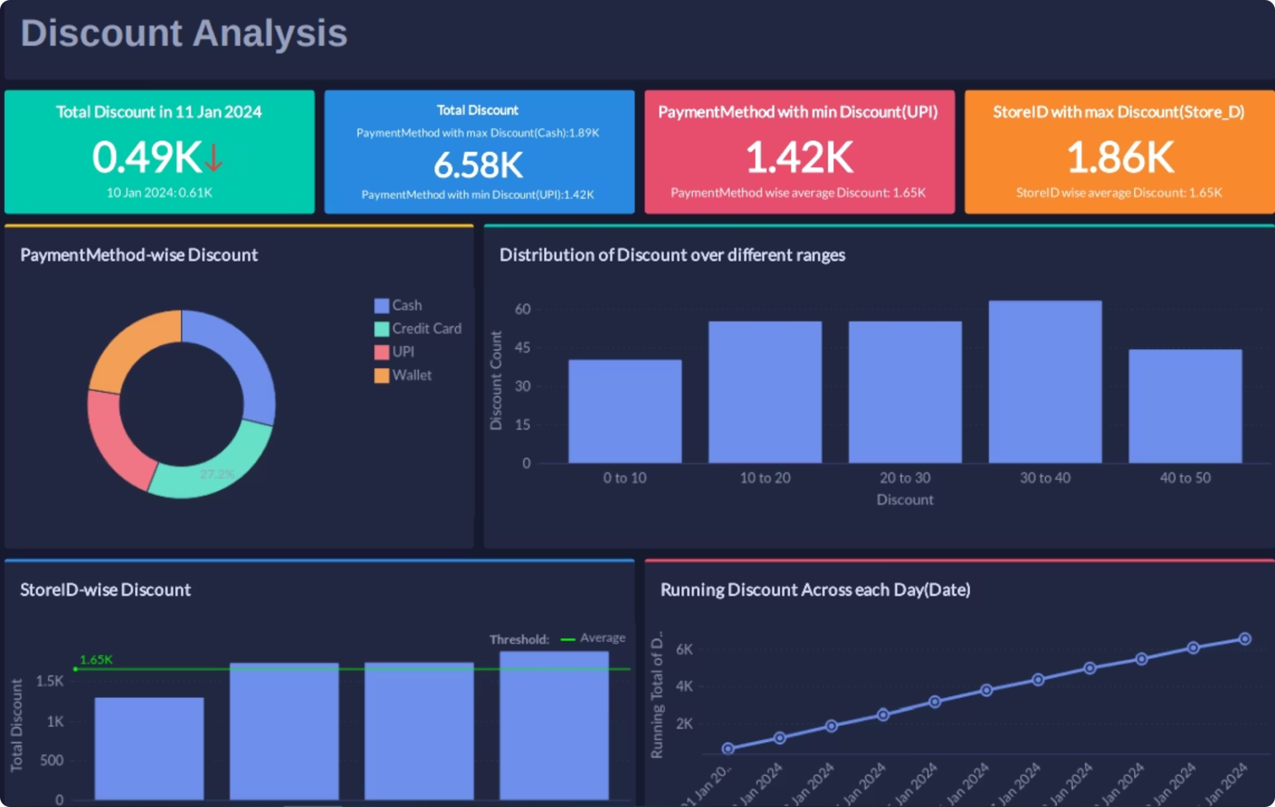
Retail Sales Analytics Dashboard and Data Integration Project
A comprehensive end-to-end data analysis workflow developed during a one-month internship at EagletFly Solutions, transforming raw transactional data into meaningful business insights through SQL integration, Python analysis, and Tableau visualization.
Submitted by: Manan Sharma
Roll No: CS-23411579
Institution: IILM University, Greater Noida, Uttar Pradesh
Program & Semester : Btech CSE & Semester 7
Organization name : EagletFly solutions

Slide 2

Project Timeline: Data Analytics Internship
During the one-month internship at EagletFly Solutions, the Retail Sales Analytics Dashboard and Data Integration Project progressed through key phases:
Week 1: June 1-7, 2025
1
Data Acquisition & SetupFocused on gathering raw transactional data and setting up the necessary development environment for analysis.
2
Week 2: June 8-14, 2025
SQL Integration & CleaningInvolved integrating data using SQL queries and performing extensive data cleaning to ensure accuracy and consistency.
Week 3: June 15-21, 2025
3
Python Analysis & EDAUtilized Python for in-depth data analysis and Exploratory Data Analysis (EDA) to uncover patterns and insights.
4
Week 4: June 22-30, 2025
Tableau Dashboard DevelopmentCulminated in the development of an interactive Tableau dashboard to visualize key business insights effectively.

Slide 3
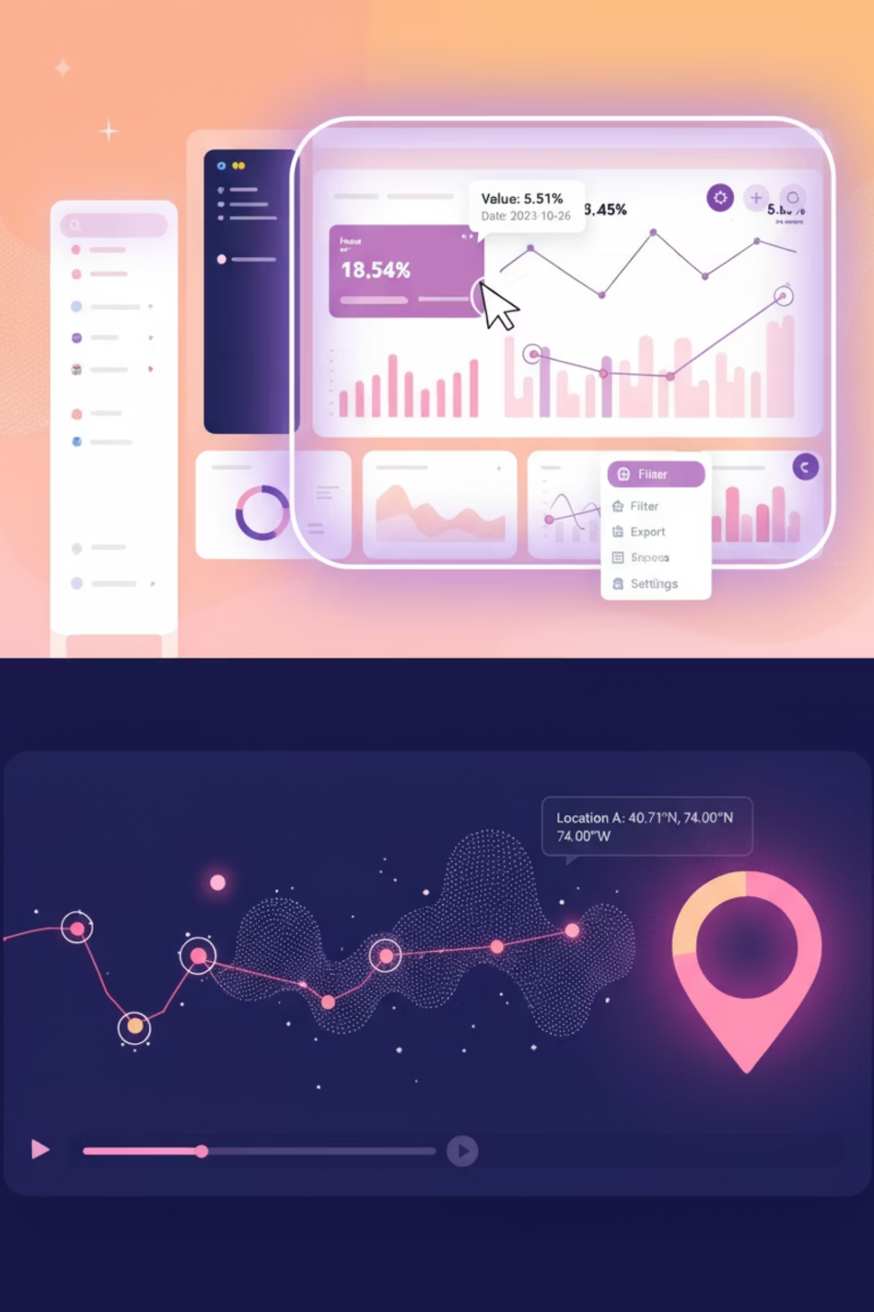

Project Overview and Objectives
Data Integration
Upload and merge customer and transaction datasets using SQL JOIN operations to create unified analytical tables
Data Cleaning
Process inconsistent, missing, and duplicate data using Python in Jupyter Notebook for accuracy
Exploratory Analysis
Conduct detailed EDA to identify patterns in profitability, discounts, and customer behavior
Interactive Dashboards
Create dynamic Tableau visualizations for discount and profit analysis to support decision-making

Slide 4

The Challenge: Transforming Raw Data
Problem Statement
Raw transactional data often contains inconsistencies, missing values, duplicates, and unstructured patterns that make direct analysis difficult. Without proper integration and preprocessing, datasets cannot reliably support business intelligence.
Key Challenges:
Integrate two separate datasets into one unified analytical table
Clean and preprocess merged data for accuracy
Identify meaningful trends in discount usage, store performance, and profitability
Present insights through interactive, interpretable dashboards

Slide 5




System Architecture and Workflow
Data Acquisition
SQL Integration
Import customers.csv and details.csv into SQL database for structured storage
Merge datasets using JOIN operations on InvoiceID, create MergedData VIEW
Python Processing
Tableau Visualization
Clean data, handle missing values, remove duplicates, conduct EDA
Build interactive dashboards for profit and discount analysis
Technology Stack
SQL (MySQL/PostgreSQL)
Python (Jupyter Notebook)
Tableau Desktop
Data validation, merging tables, creating analytical VIEWs
Pandas, NumPy for cleaning; Matplotlib, Seaborn for visualization
Interactive dashboards with drill-down capabilities and dynamic filtering

Slide 6

Implementation: SQL Data Integration
The implementation began with importing two datasets into the SQL database within the internship schema. After validating data integrity, tables were merged using an inner JOIN operation on the shared InvoiceID field, integrating customer payment details with transactional attributes.
SELECTc.InvoiceID, c.CustomerID, c.PaymentMethod, c.Discount, c.ProfitMargin, c.Profit,d.Date, d.StoreID, d.ProductID, d.Quantity, d.Price, d.TotalSaleFROM customers cJOIN details dON c.InvoiceID = d.InvoiceID;
A SQL VIEW named MergedData was created to streamline repeated queries, allowing Python and Tableau to directly retrieve clean, structured, and integrated data from a single source. This approach improved accessibility, reduced redundancy, and maintained data consistency throughout the analysis pipeline.

Slide 7
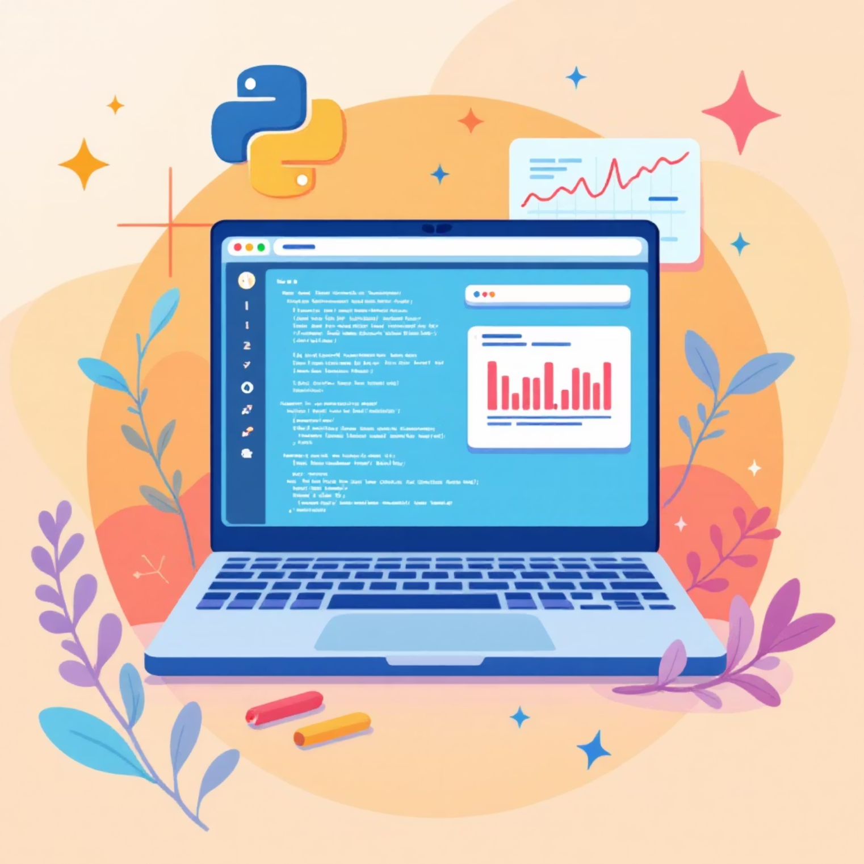
Python Data Cleaning and Analysis
Data Preprocessing Steps
01
Duplicate Removal
Ensured repeated invoice records didn't distort analysis
02
Missing Value Handling
Addressed null values using appropriate imputation strategies
03
Data Standardization
Converted date formats, corrected data types, normalized columns
04
Feature Engineering
Created derived metrics like discount contribution and profit ratios
Exploratory Data Analysis was conducted using Pandas, NumPy, Matplotlib, and Seaborn to identify trends in daily profit variations, store-wise performance, payment method behavior, and discount usage patterns.

Slide 8
Key Findings and Insights
Payment Method Performance
Store-Wise Analysis
Daily Trends
Wallet payments contributed the highest profit overall. Cash payments recorded the highest discount usage. UPI transactions contributed the least profit, reflecting lower purchase amounts.
Store_C emerged as the top-performing outlet with highest profit. Store_D showed high discount distribution. Stores A and B displayed moderate profits with room for improvement.
Noticeable fluctuations in profit and discount usage across the month. Certain days displayed strong revenue peaks while others showed dips in customer activity.

Slide 9
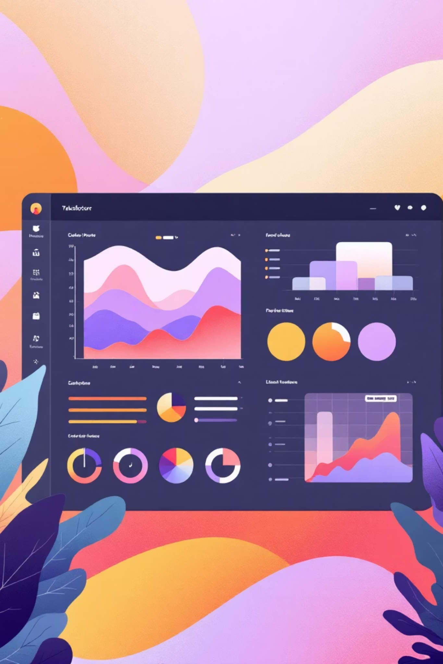
Tableau Dashboard Development
The final implementation stage involved creating interactive dashboards in Tableau Desktop. The cleaned dataset was imported and worksheets were built for comprehensive analytical exploration.
Profit Analysis Dashboard
Store-wise profit visualization
Payment method profitability comparison
Daily revenue trends and patterns
Category-level breakdowns
Discount Analysis Dashboard
Discount distribution across stores
Payment method discount patterns
Customer segment analysis
Day-wise discount trends
Each dashboard included filters, slicers, bar charts, line charts, and highlight tables to enable dynamic, drill-down exploration. Tableau's interactive environment allowed intuitive interpretation of complex patterns by business stakeholders.

Slide 10

Conclusion and Future Directions
Project Outcomes
Future Enhancements
This internship provided complete practical experience in implementing a professional data analysis pipeline. The project successfully demonstrated how raw transactional data can be transformed into meaningful business intelligence through structured workflows.
Predictive Analytics
Apply machine learning to forecast sales and customer behavior
Real-Time Dashboards
Connect Tableau to live SQL database for continuous monitoring
Key Achievements:
Integrated multiple datasets using SQL JOIN operations
Customer Segmentation
Cleaned and preprocessed data using Python
Use clustering techniques to identify customer groups
Identified actionable patterns in profitability and discount usage
Automated ETL Pipelines
Created interactive Tableau dashboards for stakeholder communication
Implement Airflow for automated data processing

